Slide 1

BY: Sarwat Majeed
(Student Leader)
Roll #: 00331141
Slot: Wednesday 7 to 10
OpenAI SDK

Slide 2

Introduction to the OpenAI SDK
The OpenAI SDK empowers developers to integrate cutting-edge AI models into their applications easily. It accelerates AI integration. The SDK supports Python and other languages.

Slide 3





What is the OpenAI SDK?
Simplifies API Interaction
Handles Authentication
Enables Quick Prototyping
The SDK abstracts complex API calls.
It manages secure access to models.
Developers can build and test rapidly.
Facilitates Deployment
It streamlines application rollout.

Slide 4





Why Use the OpenAI SDK?
Simplified API Interaction
Focus on logic, not API complexities.
Automatic Retries
Handles transient network errors seamlessly.
Streamlined Code
Reduces boilerplate, cleaner codebase.
Faster Development
Accelerates project completion times.

Slide 5
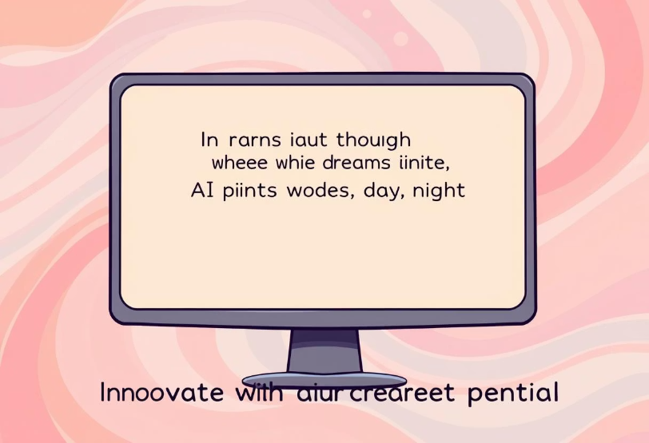
Use Cases: Content Generation
Generate diverse text formats including poems, code, and scripts. Automate content creation workflows. Create engaging marketing copy using GPT models. For example, it generates product descriptions for e-commerce.

Slide 6




Use Cases: Code Generation
Generate Code Snippets
Supports multiple programming languages.
Automate Development
Streamlines routine coding tasks.
Assist Developers
Provides code completion and suggestions.

Slide 7








Use Cases: Data Analysis
Analyze Large Datasets
Extract Insights
Process vast amounts of information.
Identify trends and patterns.
Build Custom Tools
Summarize Data
Create bespoke analysis applications.
Condense complex information.

Slide 8

Use Cases: Image Generation
Create Unique Images
Generate Art & Illustrations
Generate visuals from text prompts.
Produce creative visual content.
Integrate in Projects
Enhance creative applications.

Slide 9




When to Use the OpenAI SDK
Integrating AI
1
Into existing applications
Building New Products
2
AI-powered solutions
Automating Tasks
3
With intelligent AI
Prototyping Quickly
4
New AI solutions

Slide 10

Benefits of Using the OpenAI SDK
50%
Developer Productivity
Significant increase in efficiency.
30%
Reduced Costs
Lower development expenses.
2X
Faster Time-to-Market
Accelerated product launches.
1st
Access to AI
Cutting-edge models.

Slide 11

Conclusion
Accelerates Innovation
Simplifies Integration
With powerful AI models.
OpenAI SDK
Across diverse industries.
Key tool for AI-driven development.

